Slide 1
Photo-Realistic background generation
Ganiyu Ibraheem & Philipp Seybold
Advanced Computer Vision
Group A3

Slide 2
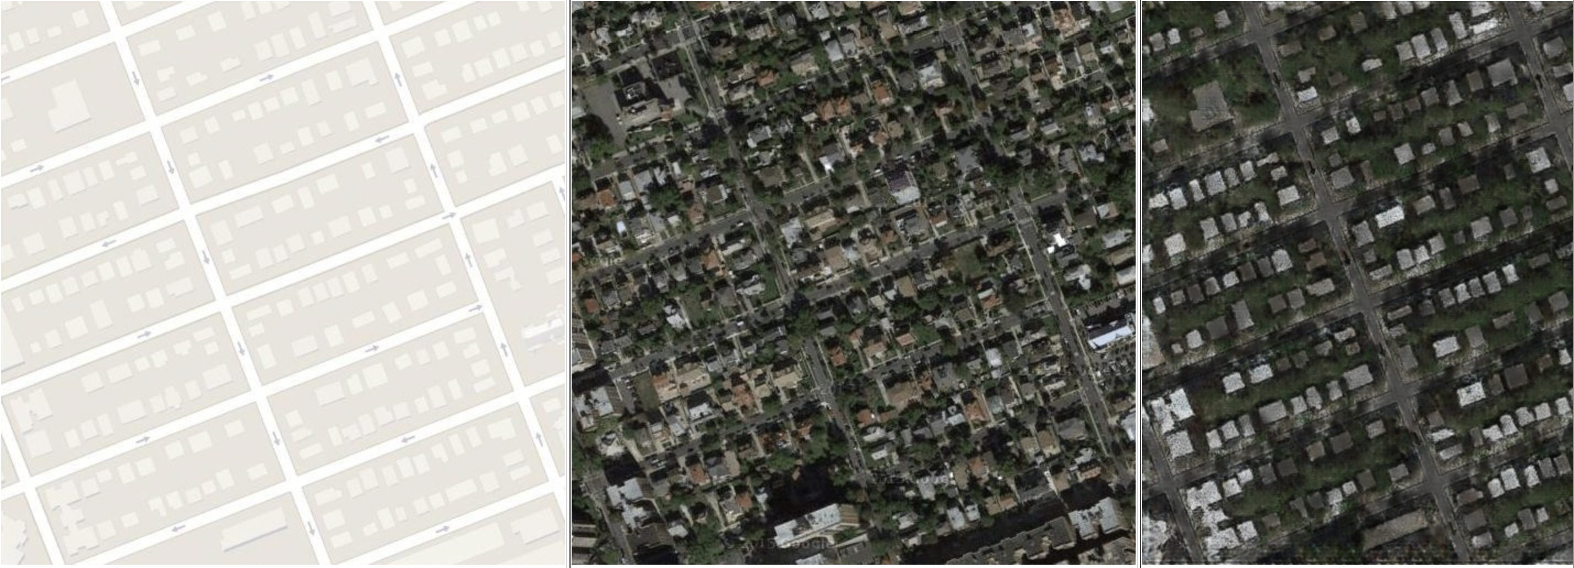
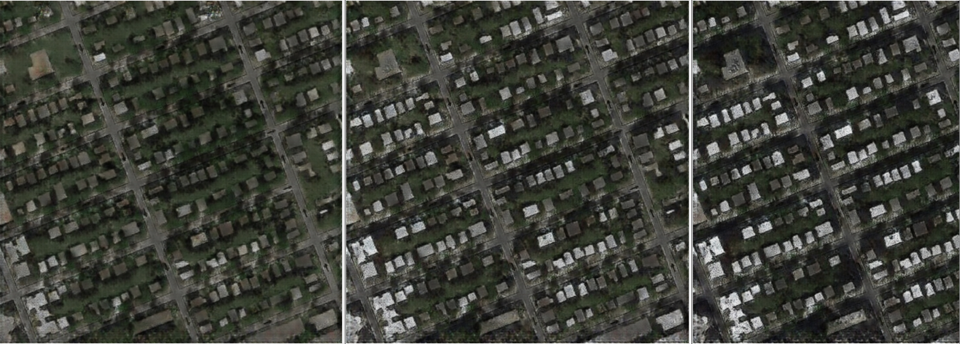
Multi-Modal Image to Image Translation

Slide 3
Overview
Introduction

Slide 4
Introduction

Slide 5
Related work

Slide 6
Multimodal image-to-image translation

Slide 7
Implementation Details

Slide 8
Sources
[1] | J.Y. Zhu, R. Zhang, D. Pathak, T. Darrell, A. A. Efros, O. Wang, E. Shechtman. Toward Multimodal Image-to-Image Translation. In NIPS, 2017
[2]
[3]
[4]
[5]

Slide 9
Work distribution

Slide 10

Discussion
Any Questions?

